Slide 1

Demand Forecasting

Slide 2
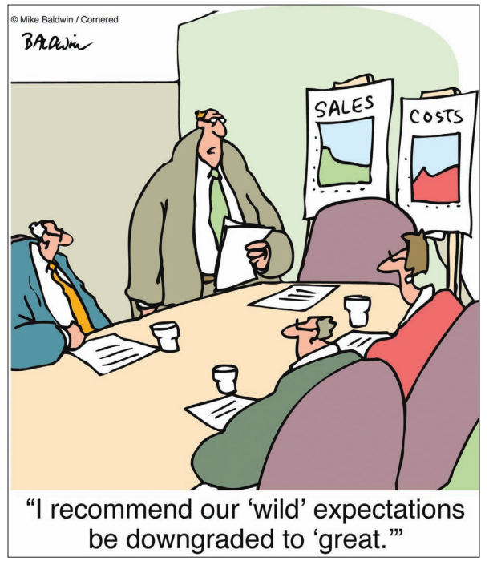
Introduction
A statement about the future value of a variable of interest such as demand.
Forecasting is used to make informed decisions.
Long-range
Short-range

Slide 3
Features
Assumes causal system past ==> future
Forecasts rarely perfect because of randomness
Forecasts more accurate for groups vs. individuals
Forecast accuracy decreases as time horizon increases
I see that you will get an A this semester.

Slide 4
Elements of Forecasting
Timely
Reliable
Accurate
Meaningful
Written
Easy to use

Slide 5
Steps in the Forecasting Process
“The forecast”
Step 6 Monitor the forecast
Step 5 Make the forecast
Step 4 Obtain, clean and analyze data
Step 3 Select a forecasting technique
Step 2 Establish a time horizon
Step 1 Determine purpose of forecast

Slide 6

Qualitative forecasting techniques
Judgmental - uses subjective inputs
Time series - uses historical data assuming the future will be like the past
Associative models - uses explanatory variables to predict the future

Slide 7
Judgmental Forecasts
Executive opinions
Sales force opinions
Consumer surveys
Outside opinion
Delphi method
Opinions of managers and staff
Achieves a consensus forecast
3-7

Slide 8
Time Series Forecasts
Trend - long-term movement in data
Seasonality - short-term regular variations in data
Cycle – wavelike variations of more than one year’s duration
Irregular variations - caused by unusual circumstances
Random variations - caused by chance
3-8

Slide 9
Techniques for Averaging
Moving average
Weighted moving average
Exponential smoothing
3-9

Slide 10
Moving Averages
Moving average – A technique that averages a number of recent actual values, updated as new values become available.
Weighted moving average – More recent values in a series are given more weight in computing the forecast.
A_{t-n} + … A_{t-2} + A_{t-1}
F_{t} = MA_{n}=
n
w_{n}A_{t-n} + … w_{n-1}A_{t-2} + w₁A_{t-1}
F_{t} = WMA_{n}=
n
3-10

Slide 11
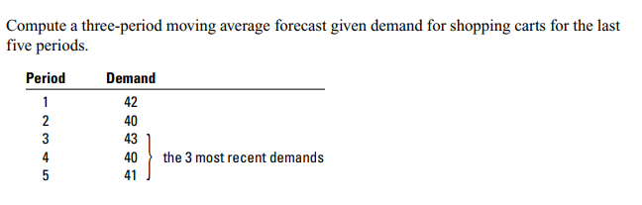
Moving Average

Slide 12
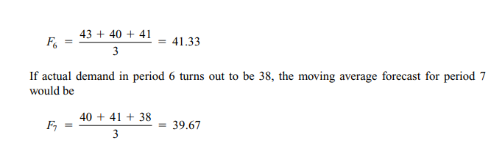
Solution

Slide 13
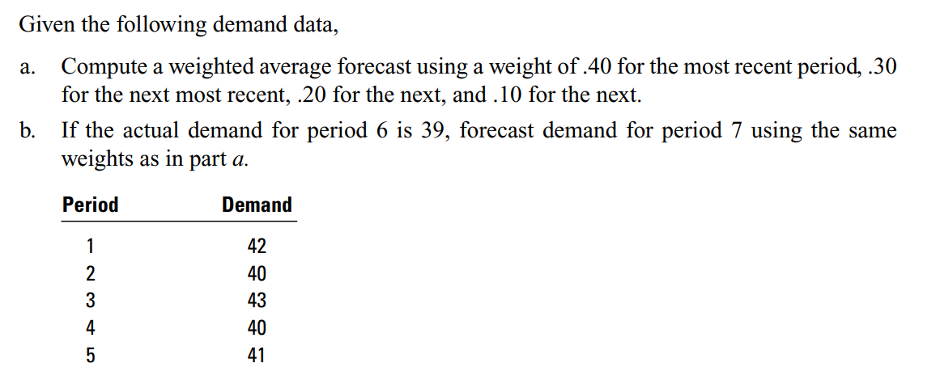
Weighted Moving Average

Slide 14
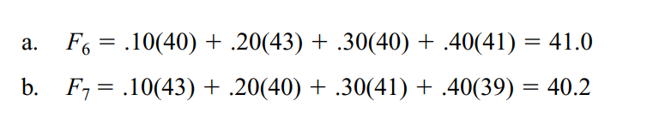
Solution

Slide 15
Exponential Smoothing
F_{t} = F_{t-1} + α(A_{t-1} - F_{t-1})
Premise--The most recent observations might have the highest predictive value.
Therefore, we should give more weight to the more recent time periods when forecasting.
3-15

Slide 16
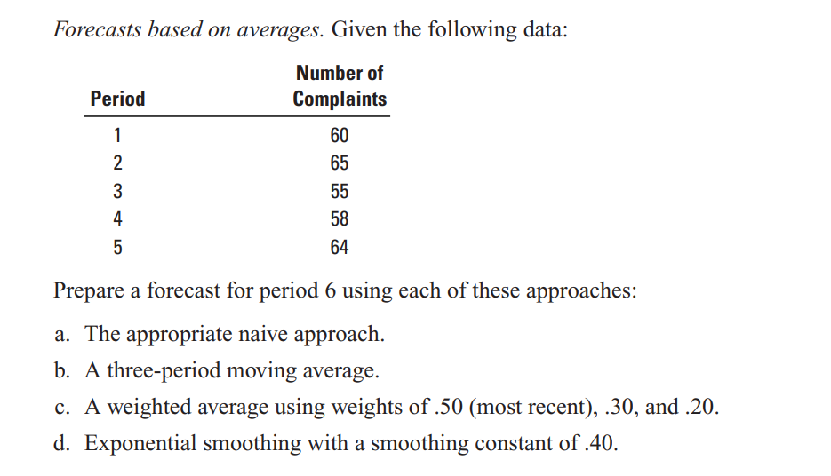
Exponential Smoothing

Slide 19
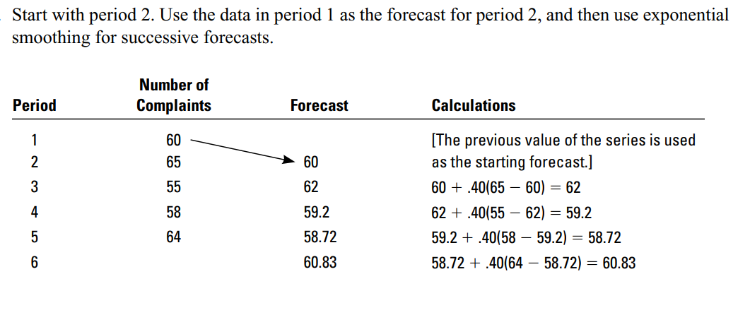
Solution

Slide 20

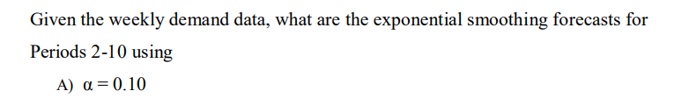
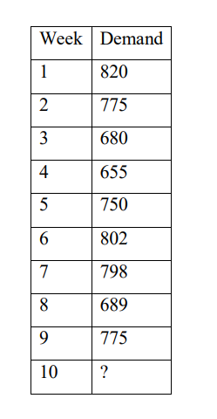


Slide 21
